Slide 1
REH ENVIRONMENTAL ASSESSMENT WG
WaSH matrix REVIEW WORKSHOP
June 10th 2024

Slide 2
Agenda
Introduction
            REH, the working group
          Participants (forms)
Origin of the Matrix
Conclusions
Notes:
jo

Slide 3










The REH
        REH
Réseau Environnement Humanitaire
Since 2012, restructured in 2021
Francophone humanitarians & development workers to reduce environmental footprint of aid
250+ members
30+ orgs
4 working groups to operationalise : waste, carbon, sustainable procurement and environmental assessments
Notes:
jo

Slide 4

The working group
        Environmental Assessments WG
Since 2021
Initially focus on NEAT+
Also explored other tools (CEDRIG, EST)
Help members and sector to use ES
Tutorials
NEAT+ feedback: 2022 and 2023
NEAT + Steering Committee member
Notes:
jo

Slide 5

MICROSOFT FORMS
Does your organisation use environmental screening tools ?
ⓘ Start presenting to display the poll results on this slide.
Notes:
jo

Slide 6
MICROSOFT FORMS
Which tools have you heard of/do you use ?
ⓘ Start presenting to display the poll results on this slide.
Notes:
jo

Slide 7
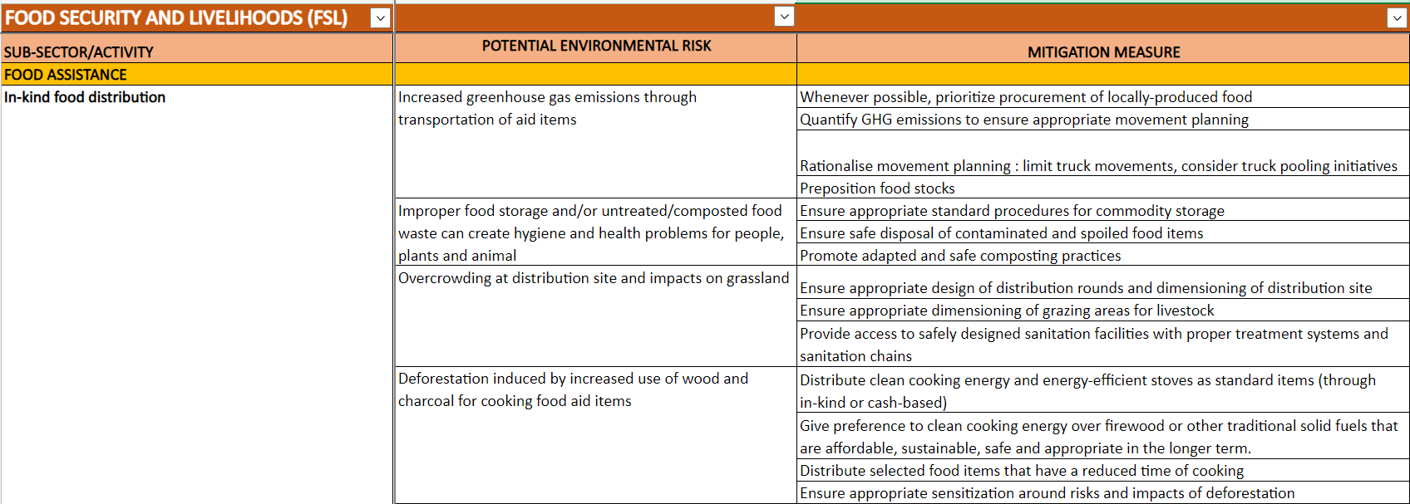
Rationale behind developing a multisectorial environmental risk analysis matrix
Not fully satisfied by the exising environmental screening tools
Real added value only comes in the adjustments that will be made in program design
Mitigation measures need to be discussed, prioritized by field team
Multi-sectoral Risk Analysis Matrix
Notes:
Pierre

Slide 8
Matrix aims to be practical and sector specific
To support sectorial teams to analyze the priority environmental risks related to their activities in their specific context
To provide recommendations in terms of mitigation measures for those risks
To guide the operationalization of the selected mitigation measures
It is a catalogue of potential environmental risks and mitigation measures per sector, sub-sector and activity
Notes:
pierre

Slide 9


A collaborative methodology for sector consensus and buy in
1
Review the content of existing tools and consolidate existing content from other tools for each sector and activity
2
Today!
Dissemination of the BETA Matrix for review and comments
3
Sectoral workshop to review the draft
June 26th
Notes:
pierre

Slide 10
Where it stands in the sector: not a new tool, but a practical alternative
Not a new tool, not replacing the existing ones
A gathering of the most relevant mitigation measures from all the existing tools and guides (NEAT+ Rural, NEAT+ Urban, ECHO MER, USAID, GAC, SIDA, …) to guide the analysis for the selected sectors and activities
This can serve as a basis/first step to review and develop further the existing tools
Notes:
Albe

Slide 11
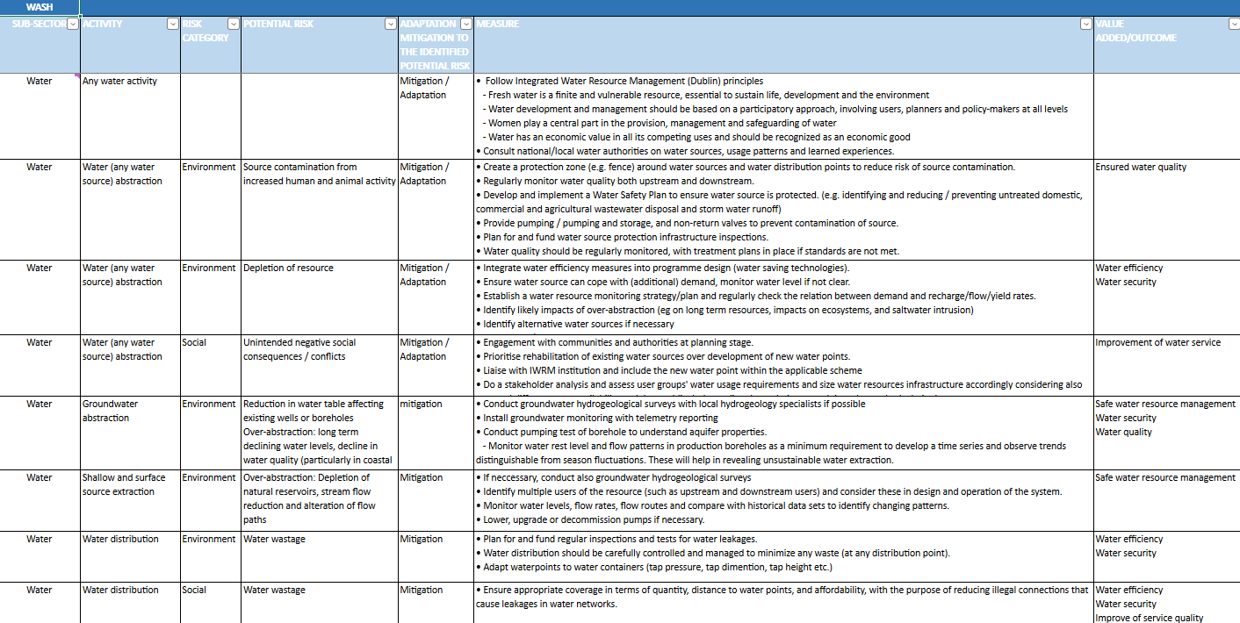
Now let’s look at the Matrix!
Notes:
Albe

Slide 12
Guidance for solo revision
1
Look at column A and B (sub-sector/activities) and mention any missing topics
2
For each activity, look at column C (Risk Category) D (potential risk) E (adaptation / mitigation), F (measure) G (Value Added / Outcome) and share any potential improvement or missing information
3
Reflect on possible missing columns
4
Provide feedback on YOUR column
Notes:
Albe

Slide 13
            Any questions?
Notes:
Albe

Slide 14
Next steps
            Individual time to review the matrix (~ 2 weeks from now): On-line version shared on 10 June
            Sectoral workshop to discuss your suggestions and review the matrix: 26 June
            In plenary we will discuss format and overarching comments
            In groups we will discuss / include the feedback for each subsectors
            Water / Sanitation (SWM and FSM) / HP & cross-cutting
Notes:
Pierre-Louis
Rural NEAT+
Urban NEAT+
EST
DG ECHO recommendations
Donor recommendations (BHA, Sida...)
Any other relevant sectoral tool (Global Shelter Cluster checklists, or GRRT for example)
This comes from an analysis developed by Action Against Hunger France which reviewed, compiled and compared donors’ environmental policies and recommendations, divided per sector.

Slide 15
MICROSOFT FORMS
To which sector do you want to register (during the workshop review in June 26)
ⓘ Start presenting to display the poll results on this slide.
Notes:
Pierre Louis

Slide 16

MICROSOFT FORMS
Any suggestions on how to disseminate it?
ⓘ Start presenting to display the poll results on this slide.

Slide 17
            Any questions?
Notes:
Pierre-Louis
Rural NEAT+
Urban NEAT+
EST
DG ECHO recommendations
Donor recommendations (BHA, Sida...)
Any other relevant sectoral tool (Global Shelter Cluster checklists, or GRRT for example)
This comes from an analysis developed by Action Against Hunger France which reviewed, compiled and compared donors’ environmental policies and recommendations, divided per sector.

Slide 18
Thank you! evalenv@environnementhumanitaire.org

